Slide 1

SUBJECT: BLOCKCHAIN TECHNOLOGY
Assignment 1
Made by Ali Atchibayev, Ualikhan Kamarov, Alibi Kemelbek

Slide 2

In this Presentation
Here's what we'll cover:
Assymetric encryption
Cryptography
Digital Signatures
Blockchain
Merkle tree

Slide 3
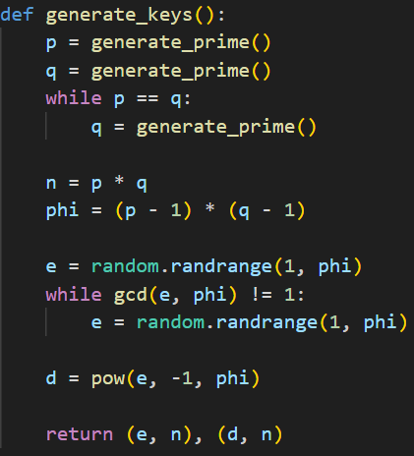
Generating keys
RSA key generation process:
p and q - prime numbers.
n - modulus
phi - Euler's Totient
e - public key
d- private key

Slide 4
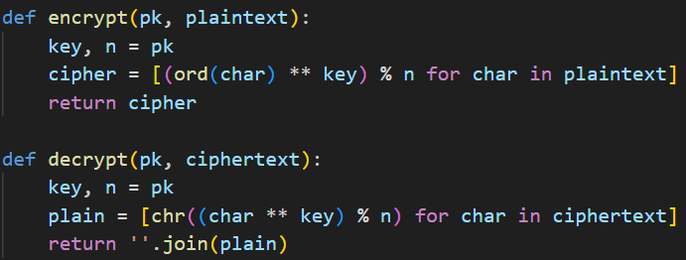
Encrypt
pk - PUBLIC key
plaintext - message to encrypt
cipher - encrypted message
[(ord(char) ** key) % n for char in plaintext]
encrypting every character by this expression

Slide 5
Decrypt
pk - PRIVATE key
ciphertext - message to decrypt
plain - decrypted message
[chr((char ** key) % n) for char in ciphertext]
decrypting every character by this expression

Slide 6
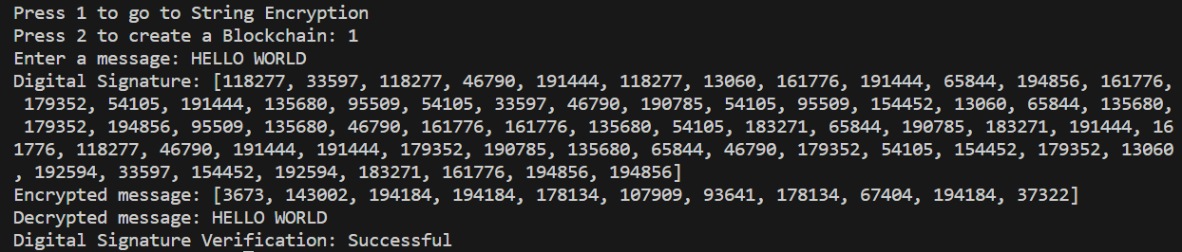
This is how it looks

Slide 7
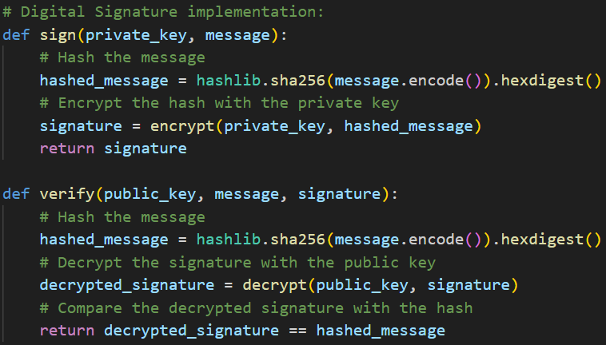
Digital Signature
A digital signature must guarantee the authenticity of a person.
For this, we are using hashing, private key and RSA encryption.
Digital signature - is an encrypted hashed message.

Slide 8
Digital Signature
hashed_message - using hashing (hashlib) to hash the message.
signature - Digital Signature (encrypted hashed messages).
two options: sign and verify.
if decrypted_signature == hashed_message is TRUE
then the message is valid authenticity of a person.

Slide 9
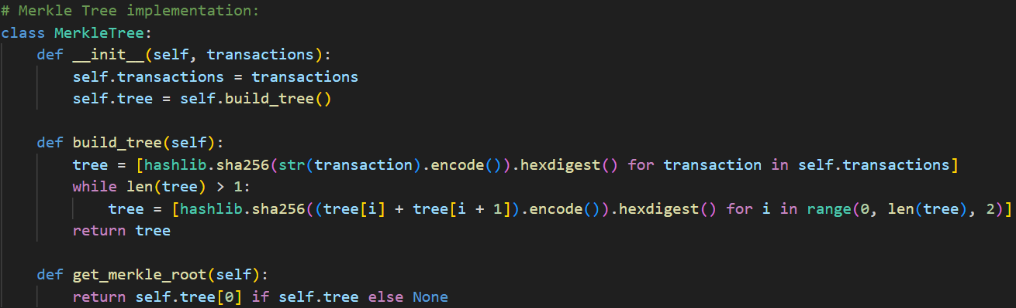
Merkle Tree

Slide 10
Merkle Tree
Merkle Tree is a very efficient way to verify the integrity of large datasets.
transactions - a list of transactions where Merkle Tree is to be constracted
tree - Merke Tree
Merke Root - a hash of tree’s first transaction

Slide 11
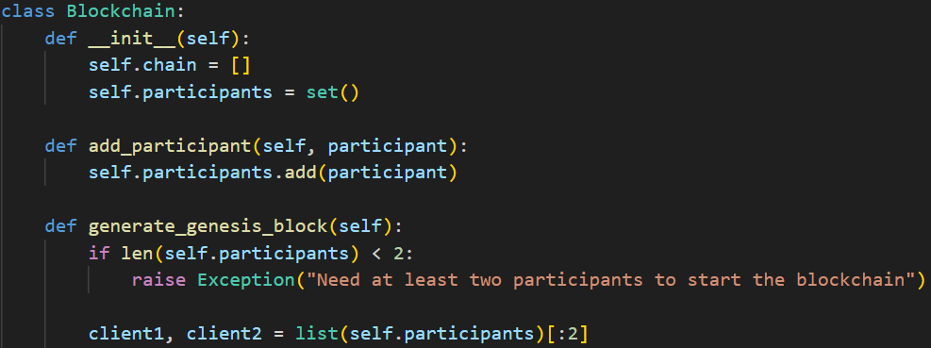
Blockchain

Slide 12
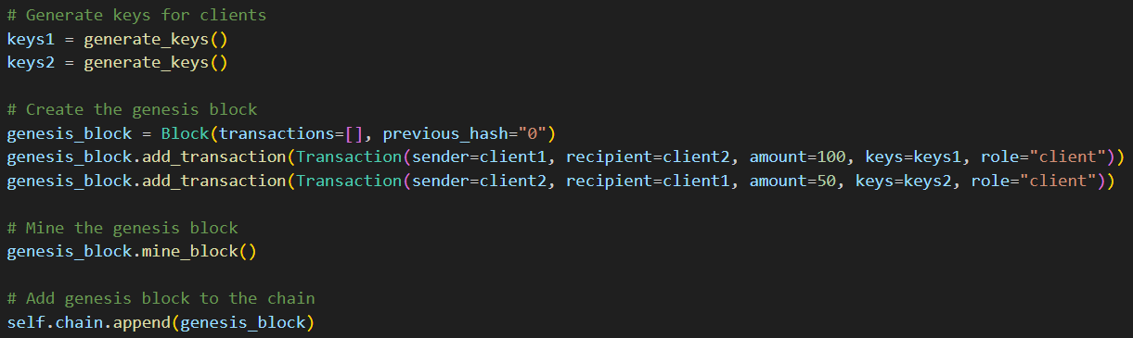
Blockchain
genesis block = first blockchain’s block.
Requires at least two participants.
Creates keys for two participants using the generate_keys().

Slide 13
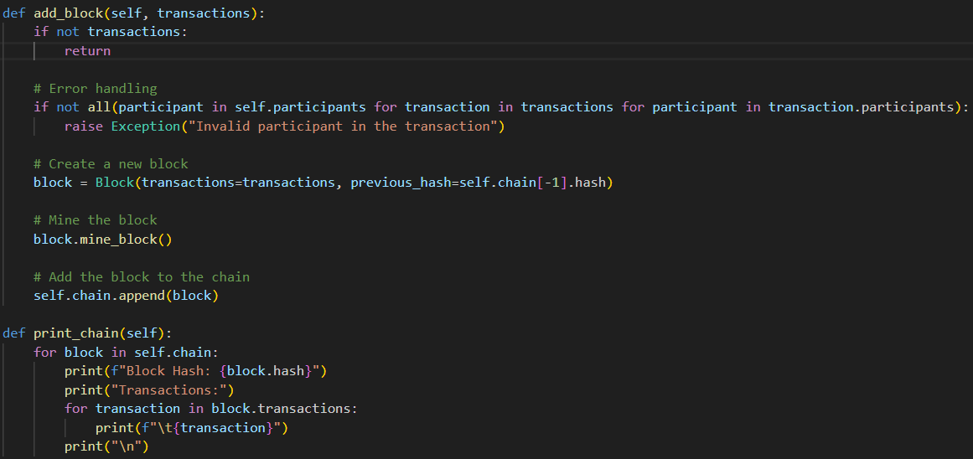
Blockchain
Adds a new block to the blockchain with the provided list of transactions.
Performs error handling to check the validity of participants in the transactions.
Creates a new block with the transactions and the hash of the last block in the chain.
Adds the new block to the chain.

Slide 14
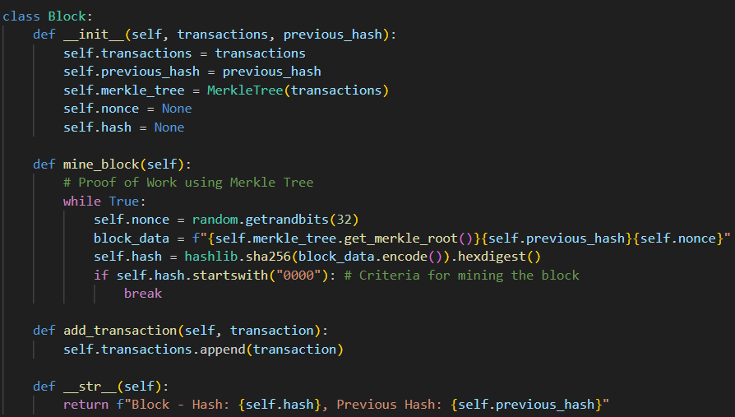
Blockchain
Block has only a previous block’s hash.
nonce - a random value used in mine_block().
hash - the hash of the current block.
mine_block() - continuously generates random values for the nonce until a hash is found.

Slide 15
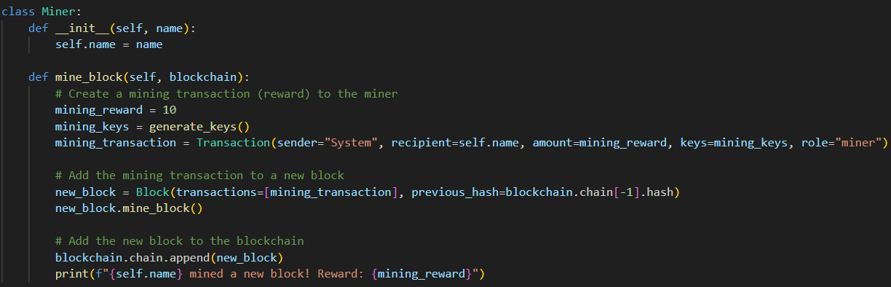
Miner
Miner class, representing a participant in the blockchain who is capable of mining new blocks.
Blockchain - an instance of the Blockchain class on which the miner will mine a new block.

Slide 16
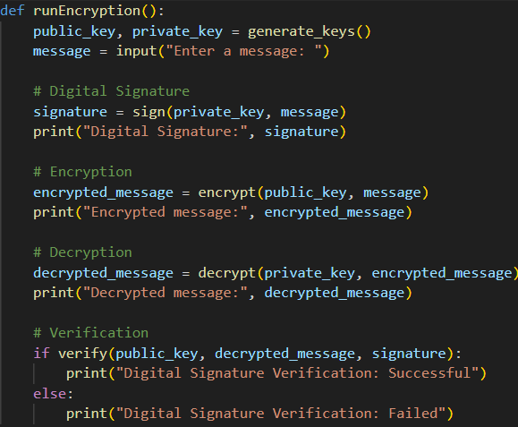
Realisation of Encryption

Slide 17
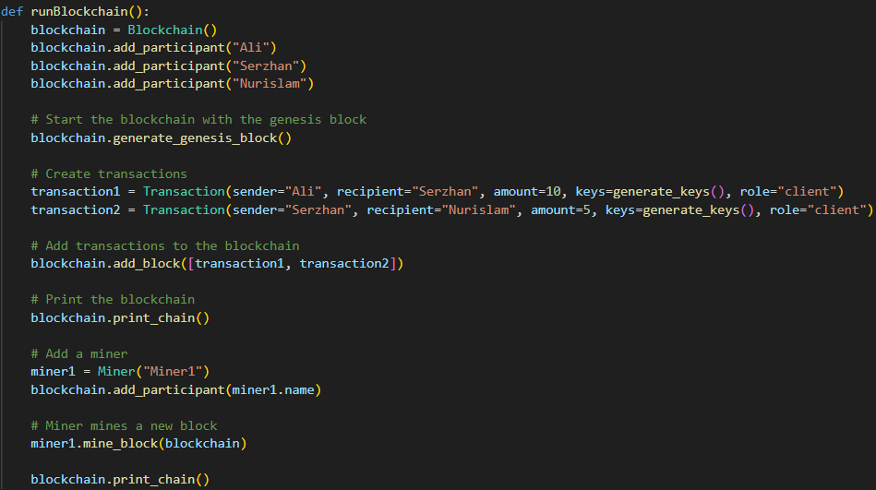
Realisation of Blockchain

Slide 18
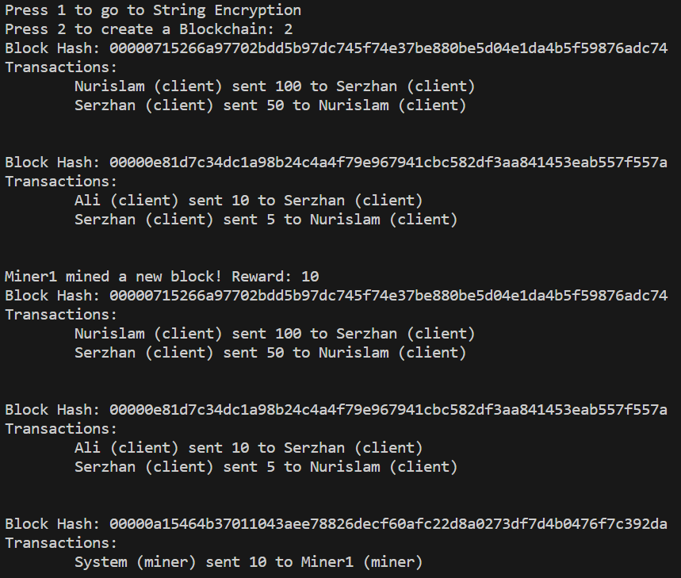
Realisation of Blockchain

Slide 19
THANKS FOR ATTENTION
Made by Ali Atchibayev, Ualikhan Kamarov, Alibi Kemelbek

